Slide 1


React JS
Presenting by:
Satheesh Babu
[eBusiness – Fullstack Developer]
Paramhans Dubey
[eBusiness – Fullstack Developer]

Slide 2
React Introduction Component State Routes Props Redux Context etc
TOPICS/Agenda
Notes:
Delete this slide when you finish preparing the other slides.

Slide 3


What is React Js
Notes:
Do you remember how Facebook’s UI or it’s messenger looked a few years back? During that time you had to refresh or reload the entire page for new updates or messages repeatedly. But now it’s no longer required. Today, each time there is a new update or message, a notification will pop up. Clicking on that will then automatically refresh your page and show you the latest updates. So, how exactly does this happen? Well, this is the magic of ReactJS and in this blog, I am going to discuss what is React and why you should go for it. But before we proceed to see what is react, let’s take a look at the topics I will be discussing:

Slide 4
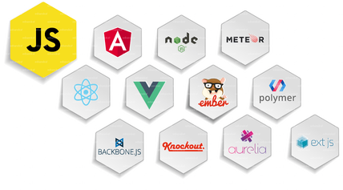
JavaScript Frameworks
Javascript is a dynamic programming language which is widely used for developing web applications.
It is very lightweight and is supported by most of the modern browsers
Notes:
Following are the major advantages provided by the JavaScript Frameworks:
Efficiency: With the use of pre-built patterns and functions, the development of the applications became easy. The projects which used to take months to develop can now be developed in very less time. This increased the efficiency as well as reduced the time and effort involved.
Security: As JavaScript is an open source community, its top frameworks have strong security arrangements. Frameworks are supported by these large communities in which, the members and the users can also act as testers. This increases the chances of detecting any kind of backdoor or bug present in the framework. Thus providing better security at less cost.
Cost Reduction: JavaScript Frameworks are free for public use as they are open source. So, when we develop a web application using these frameworks, the overall cost of the application is much lesser.

Slide 5

React is a component-based library which is used to develop interactive UI’s (user interfaces). It is currently one of the most popular JavaScript front-end libraries which has a strong foundation and a large community supporting it
So What is React?
Notes:
NOTE: ReactJS is only a frontend library and not the whole framework, which deals with the View component of MVC (Model – View – Controller).
Manipulating DOM was very expensive.
This is where ReactJS comes to our rescue. With ReactJS, you can divide your entire application into various independent components

Slide 6
Library vs Framework in Js
Both frameworks and libraries are code written by someone else that is used to help solve common problems.
A library is just a collection of class definitions. The reason behind is simply code reuse. Follow DRY.
function getWords(str) {
const words = str.split(' ');
return words;
}
function createSentence(words) {
const sentence = words.join(' ');
return sentence;
}
Notes:
Developers often use the terms “library” and “framework” interchangeably. But there is a difference.

Slide 7
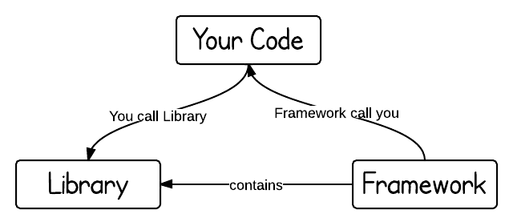
…Contd
The key difference between a library and a framework is "Inversion of Control“.
A framework inverts the control of the program. It tells the developer what they need. A library doesn’t. The programmer calls the library where and when they need it
Notes:
Angular, Vue js are Frameworks.
- Have to follow standards.
- hard to Customize and deviate
Jquery, React, D3 Js are libraries.

Slide 8
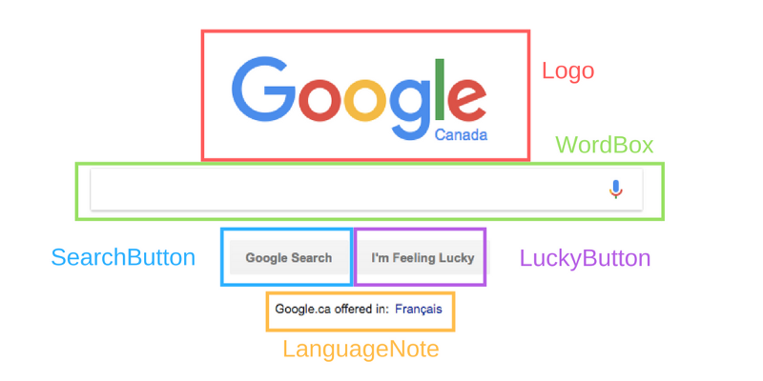
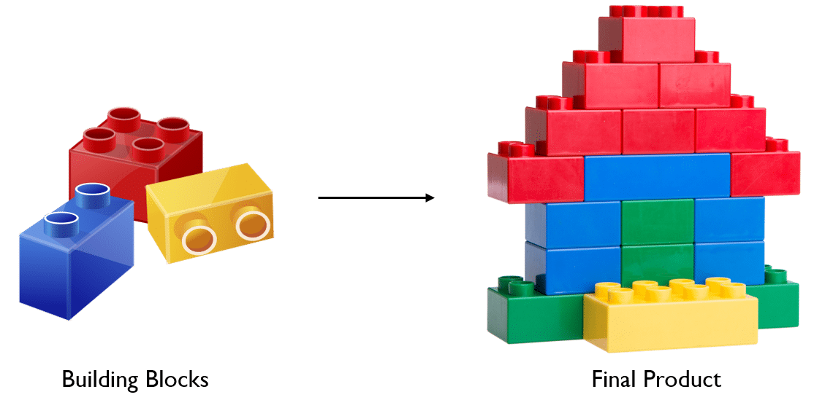
React makes user interfaces very easy to build by cutting each parts page into pieces. We call these pieces COMPONENTS.

Slide 9

React Architecture

Slide 10
Virtual DOM

Slide 11
JSX

Slide 12

Brainstorm Group(s)
Brainstorm Grouping
Brainstorm Grouping
Brainstorm Grouping
Expectations
Expectations
Expectations

Slide 13

Timer
Insert a timer here for the amount of time you would like students to brainstorm as you walk around, listen, and discuss ideas with them
See the notes section for ideas on what a lesson could look/sound like

Slide 14


Looks LIKE SOUNDS Like
LOOKS LIKE | SOUNDS LIKE
Type or ink answers students suggest- modifying language as necessary | Type or ink answers students suggest- modifying language as necessary

Slide 15
Customize this Template
Template Editing Instructions and Feedback

